Slide 1

Read Write Inc.
Parent Workshop

Slide 2

Reading
•What is phonics and how can I support with learning new sounds?
•How is reading taught at school?
•How can I support with reading at home?

Slide 3





Reading at home
Why is it important to read at home?
Hearing your child read every day helps them with their decoding skills.
Reading stories to your children can help develop their love of reading and increases their vocabulary significantly.
Child A reads 20 minutes per night 5 times a week | Child B reads 4 minutes or less per night
In one week 100 minutes reading | In one week 20 minutes reading
In one month 400 minutes reading | In one month 80 minutes reading
In one school year 3,600 minutes of reading | In one school year 720 minutes reading
By the end of year 6 28,800 minutes of reading (80 school days) | By the end of year 6 5,760 minutes reading (16 school days)

Slide 4
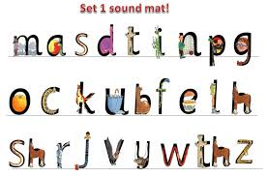
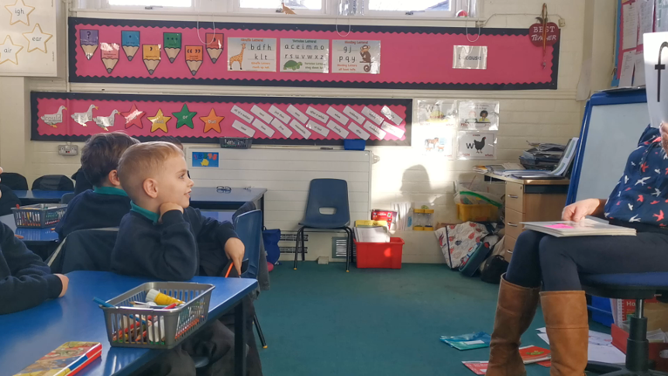
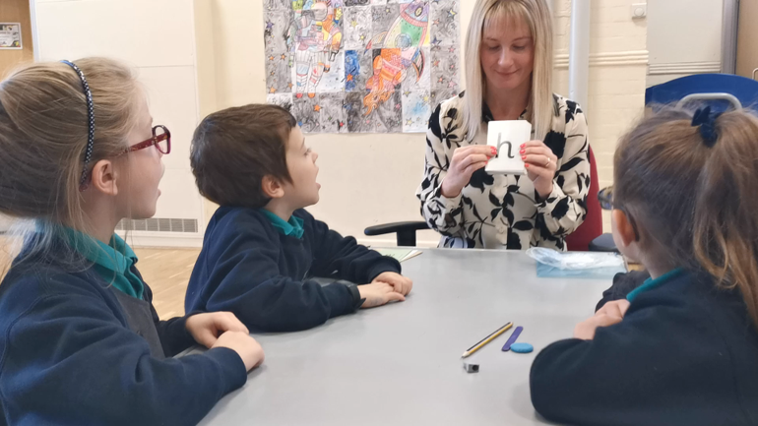
Pure sounds link to character or phrase

Slide 5
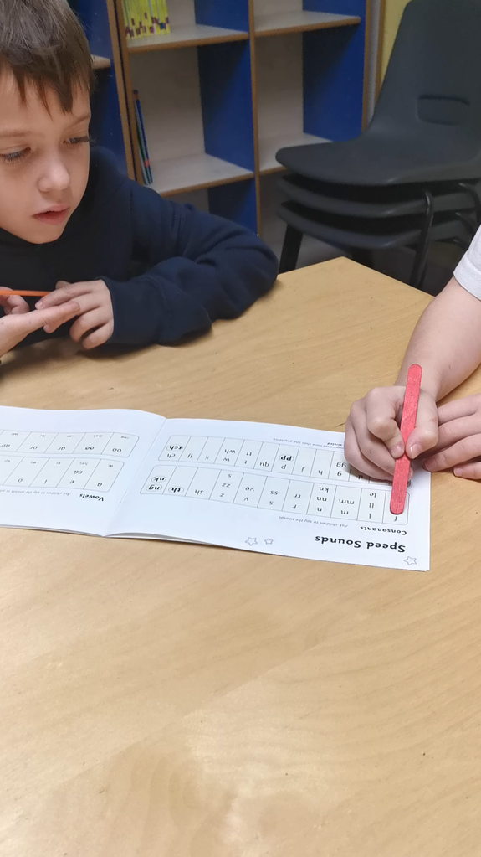
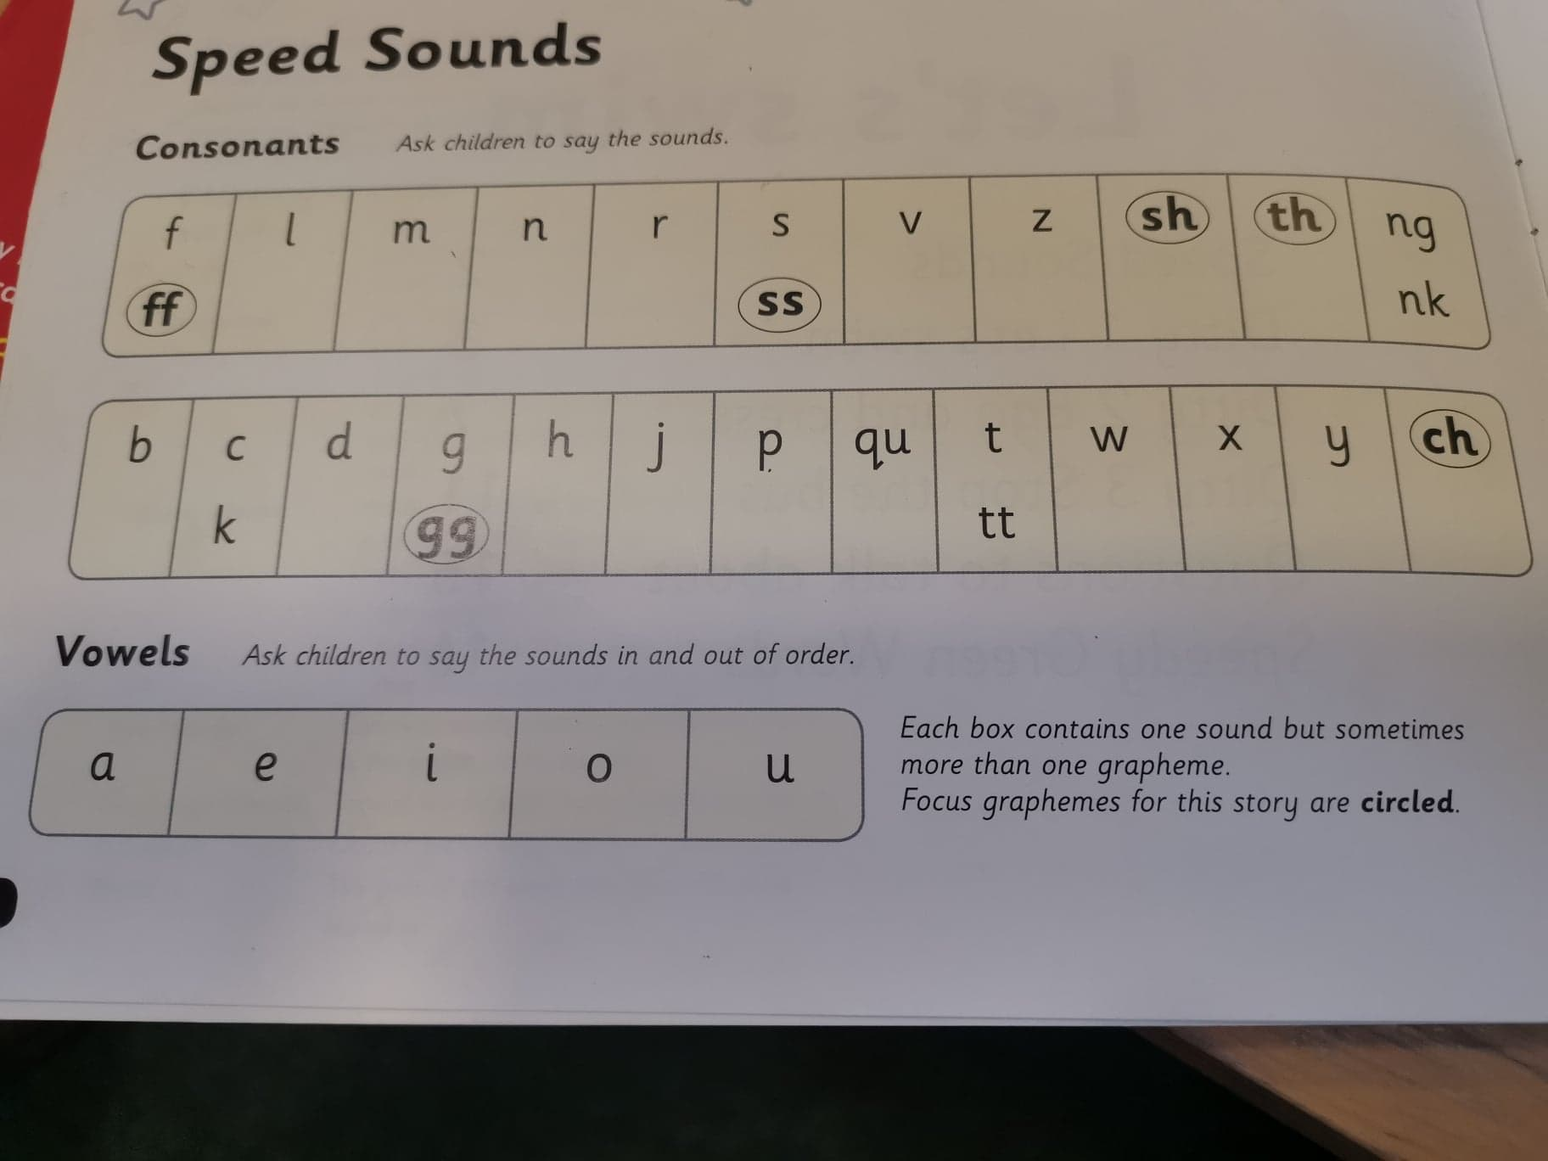
RWI Reading books
Ask your child to say each speed sound every time you read the book.
Make sure you do the vowels at the bottom!
Point to each sound with a lolly stick.
Make sure that they use the ‘pure sound’.

Slide 6
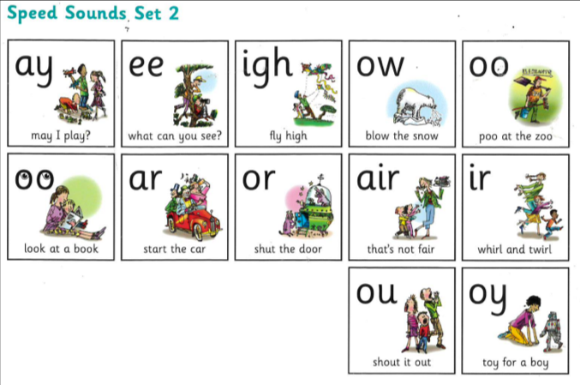
Set 2 sounds - Green to pink

Slide 7
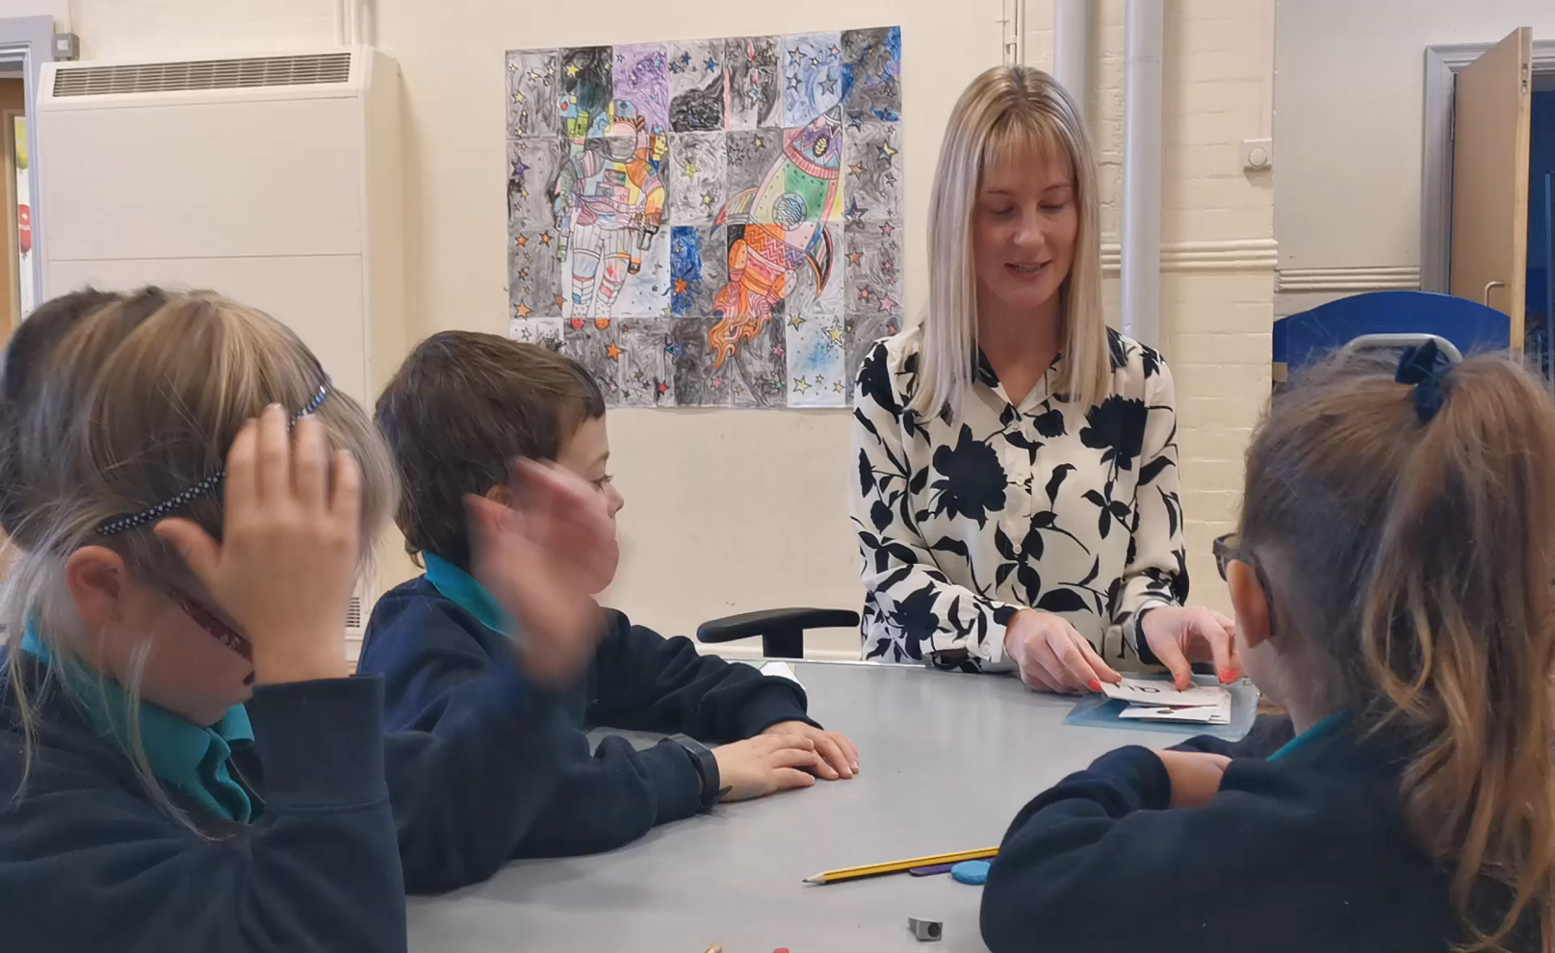

Slide 8
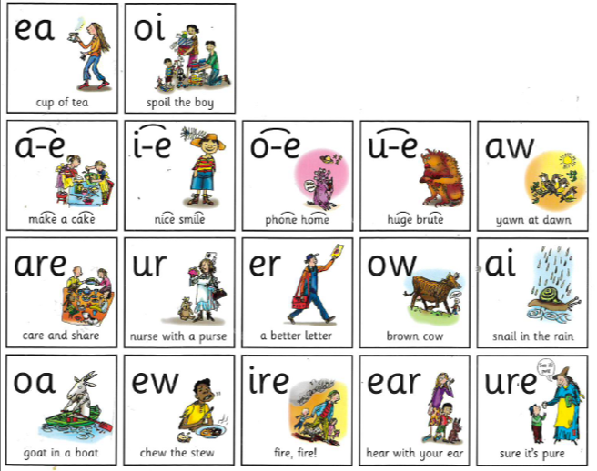
Set sounds 3 - orange to grey

Slide 9
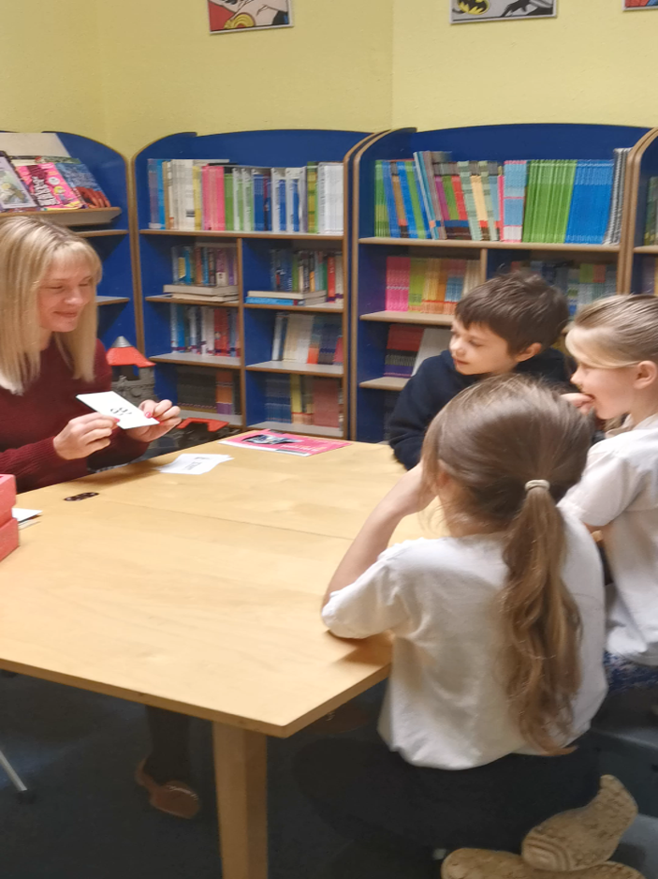
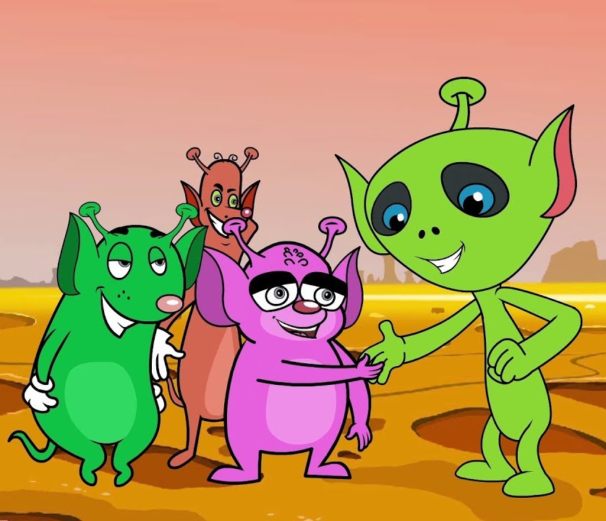
Applying the sounds
As part of each session we apply the sounds using alien words – words that do not make sense.
This is also important as it is part of the phonics screening test.

Slide 10
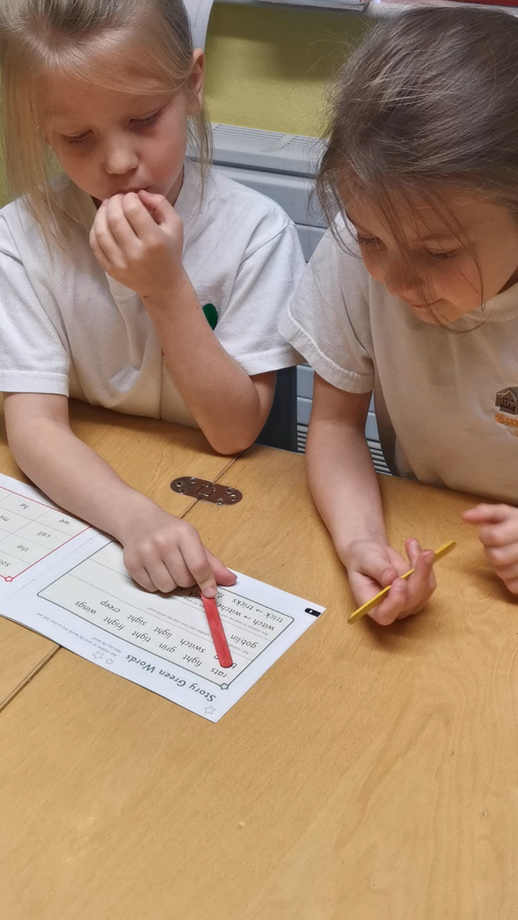
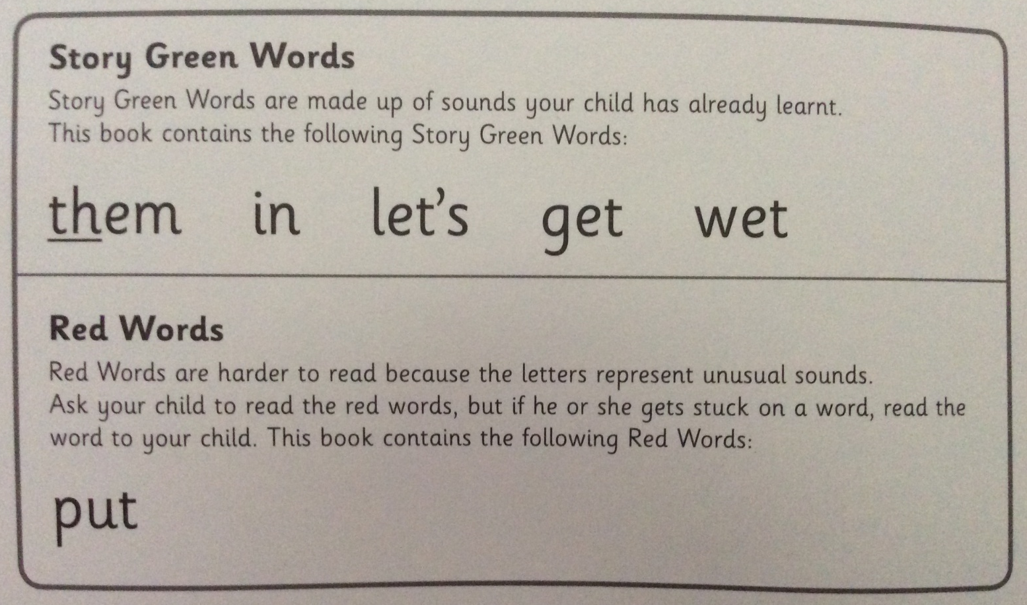
Green story words
These are found in the front of the book.
Pick out special friends.
Important to read these as they are key
to the story and will be new vocabulary.
Reinforces sounding out.

Slide 11

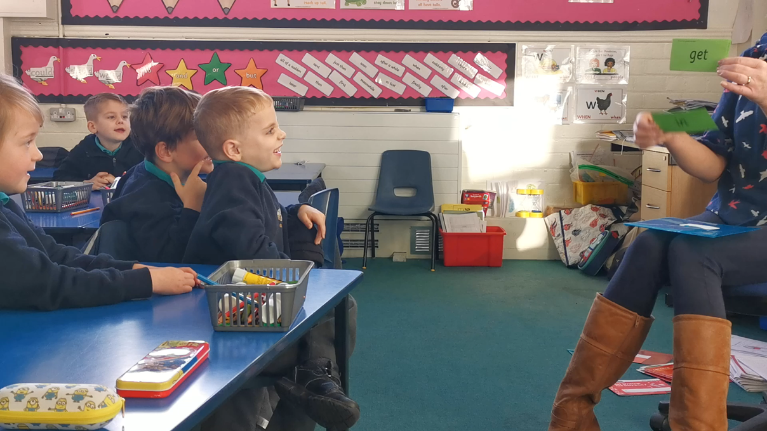
Speedy Green Words
These words need to be read instantly.

Slide 12
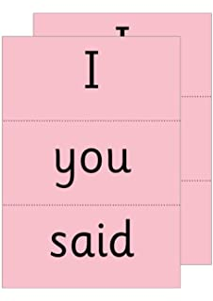
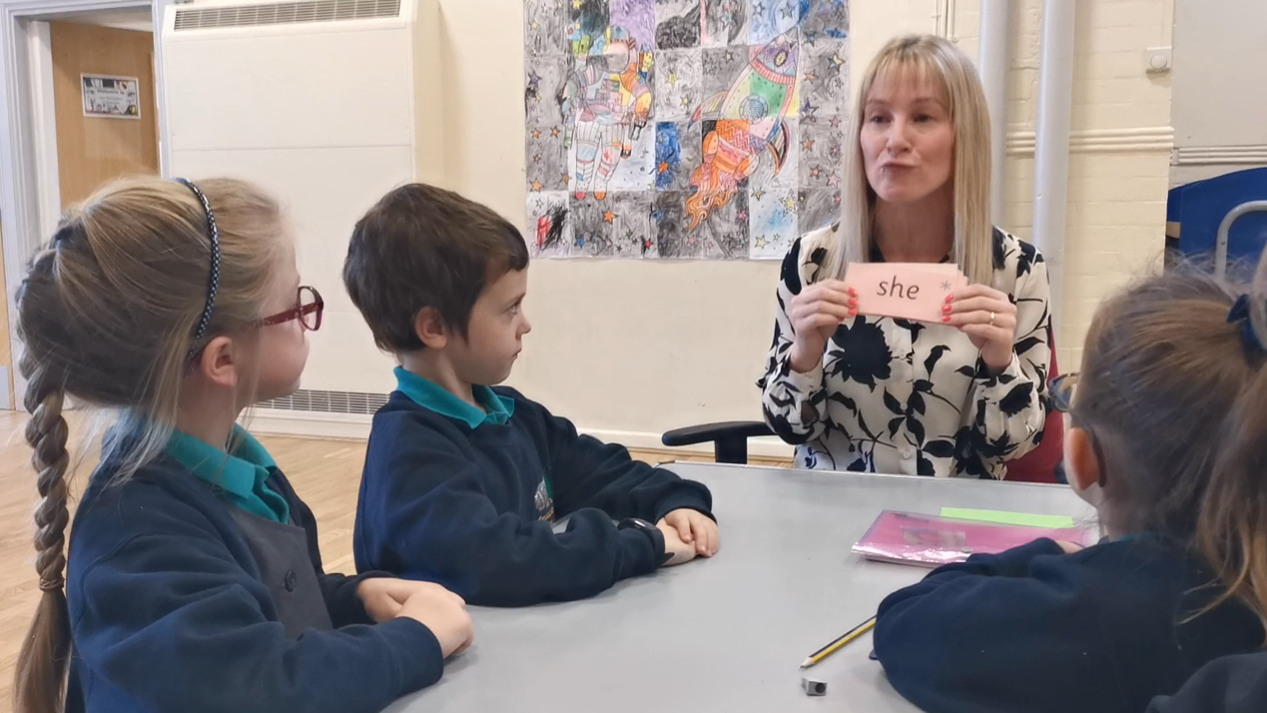
Red words
These are words highlighted in red in the book.
These are high frequency words that can not be sound out.

Slide 13
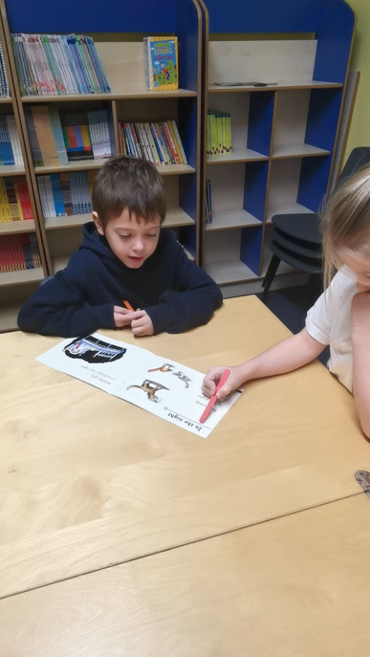
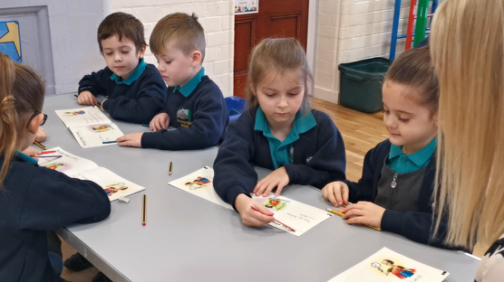
Reading the story
Do not read the story to them first, let them have a go, helping them to sound out and blend.
Re read the sentence once all words are decoded to keep plot moving.
Then re read the story to your child but pausing for them to jump in.
Retell the story using the pictures, this is in their own words.
Questions to chat about!

Slide 14

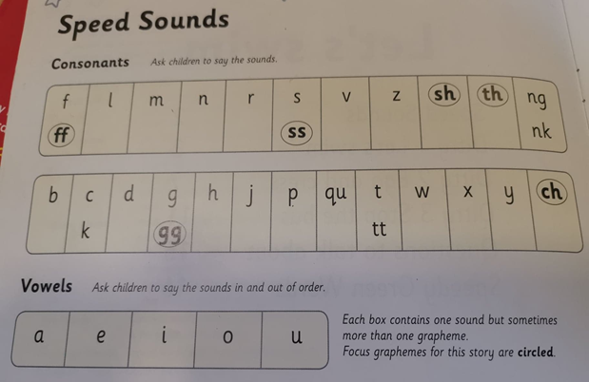
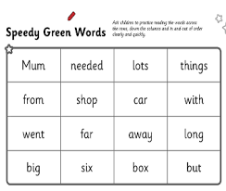
What will come home?
Speed sound chart
Speedy green words worked on in class
2 books
Some will get an activity sheet, 1 to start with then review.

